Slide 1

Capstone Projects Toxic Comment Classification Ezgi Orhan
Notes:
UP logosunu her sayfada transparent kullanmak daha güzel olur.

Slide 2
Content
My story
Explanatory Data Analysis
ML models
Conclusion
Up school experience

Slide 3

My story
Mechanical Engineer (Bilkent University 2015)
Reliability Engineer
Up School - Machine Learning

Slide 4
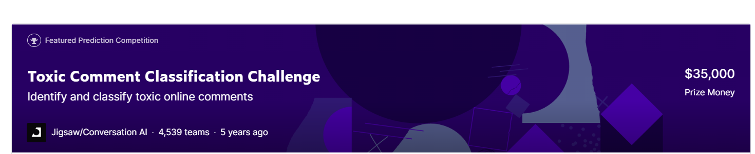
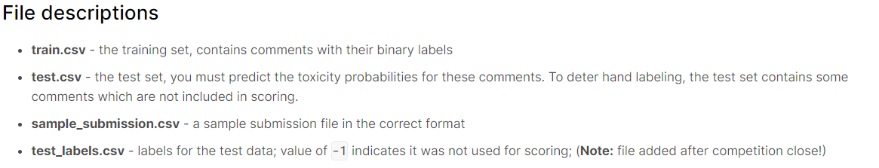
Toxic Comment Classification
toxic
Severe toxic
obscene
threat
insult
Identity hate

Slide 5
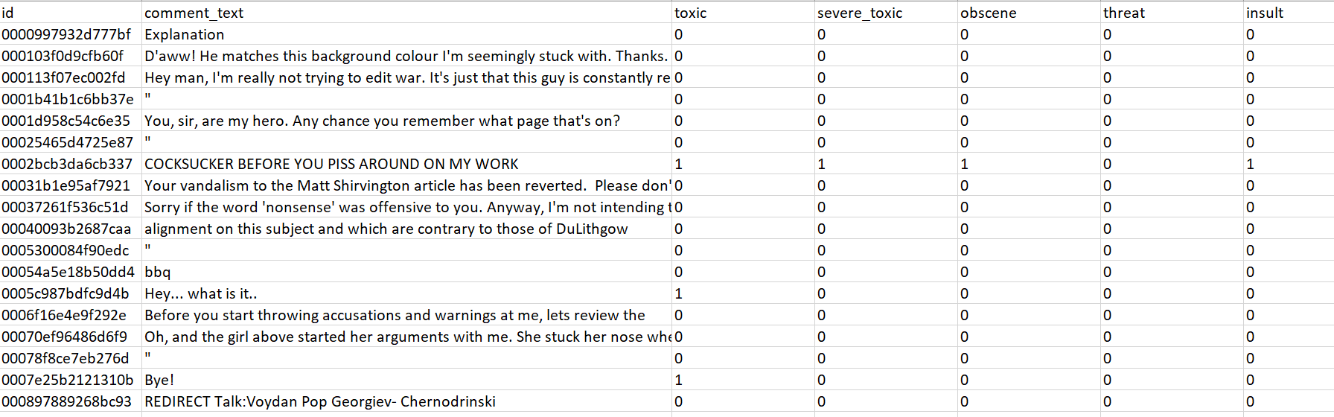

Slide 6
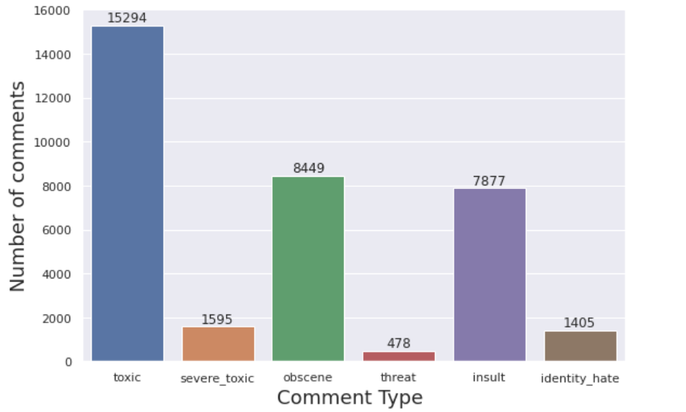
Explanatory Data Analysis

Slide 7
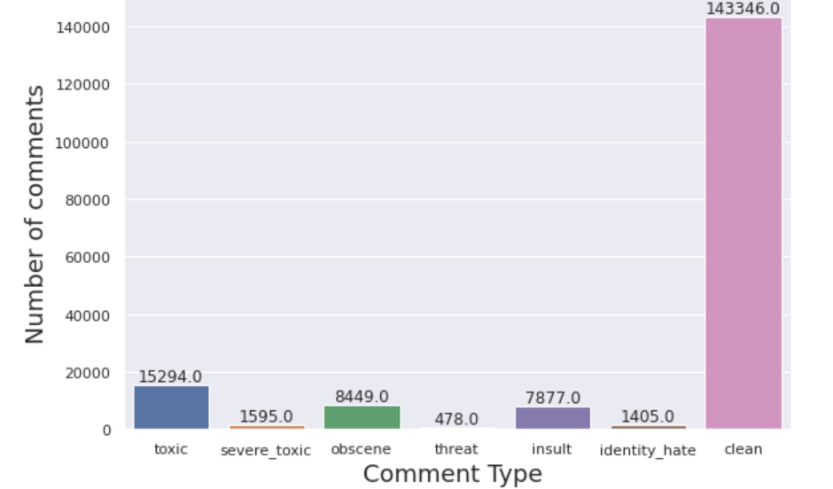

Slide 8
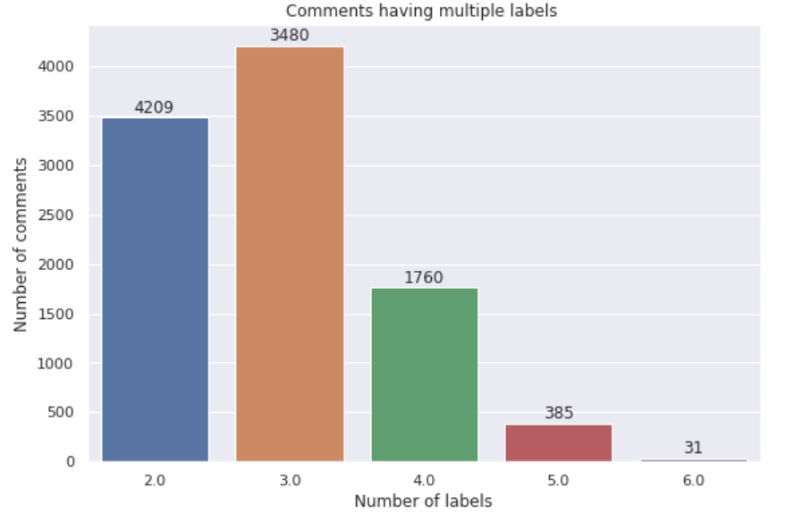

Slide 9
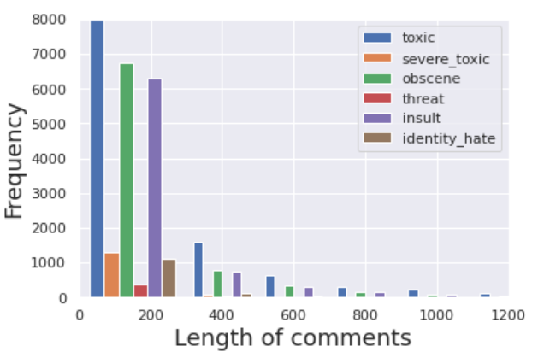

Slide 10
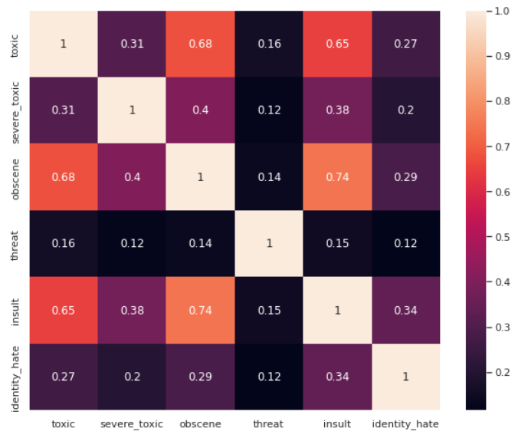

Slide 11
Preprocessing
Train sentences, labels and test sentences, labels
Remove stop words
Train_val_split function → split data to train and validation
Tokenizer
Padding

Slide 12
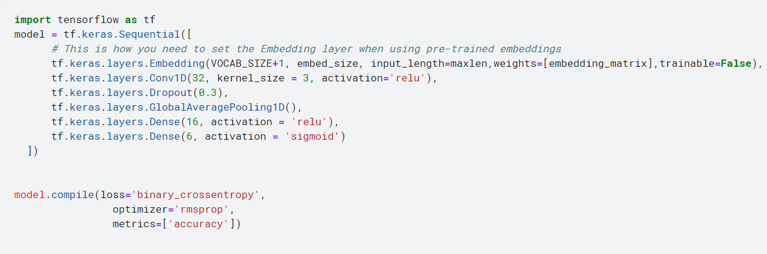
Glove Embedding
Conv1d

Slide 13
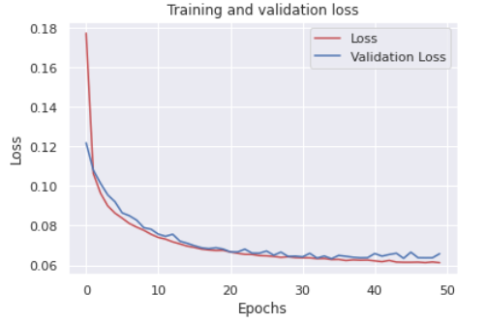

Slide 14
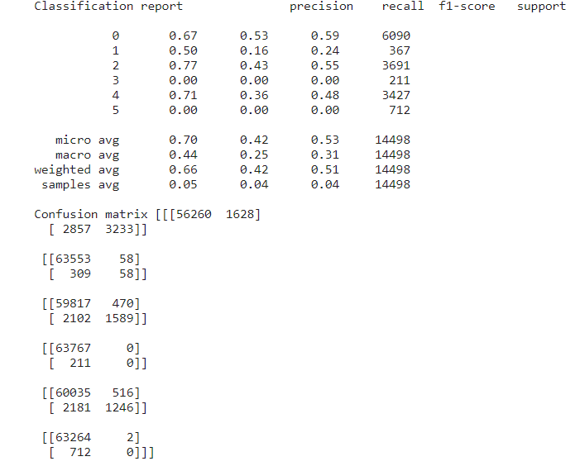

Slide 15
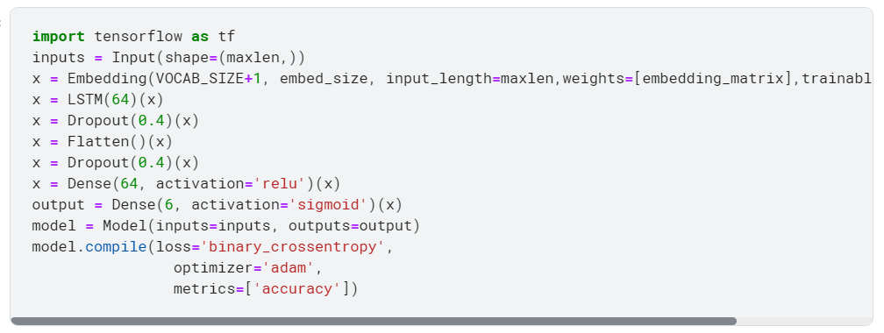
LSTM

Slide 16
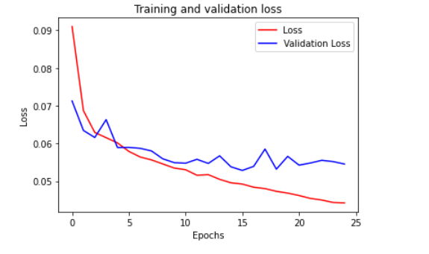

Slide 17
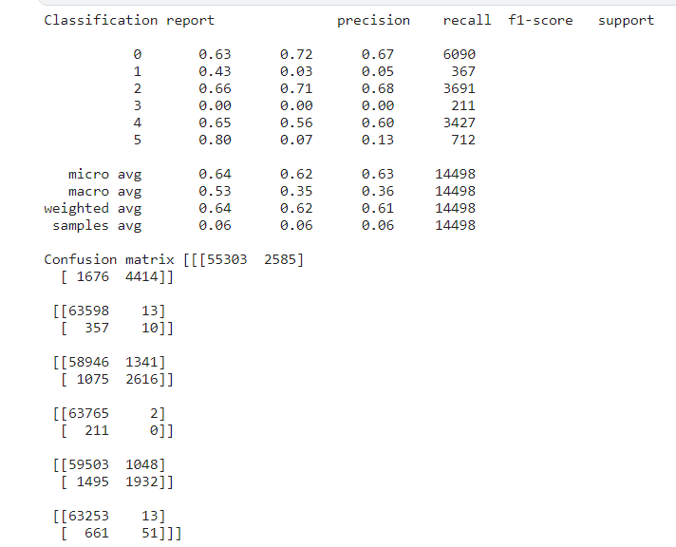

Slide 18
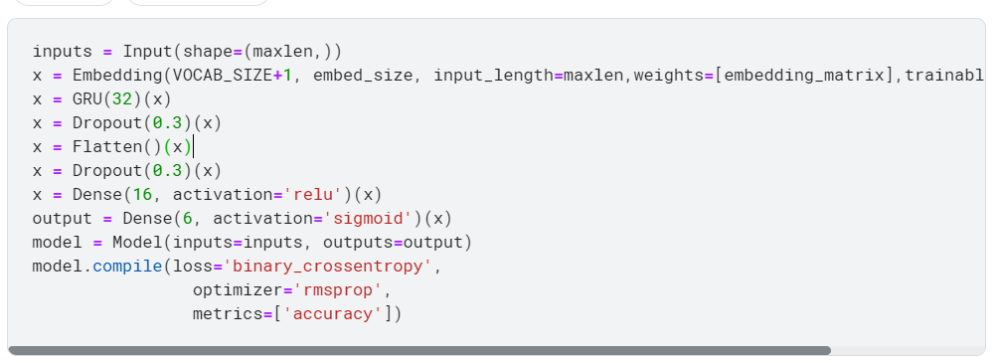
GRU

Slide 19
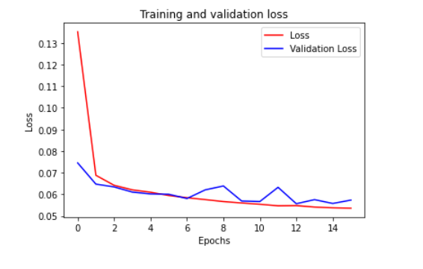

Slide 20
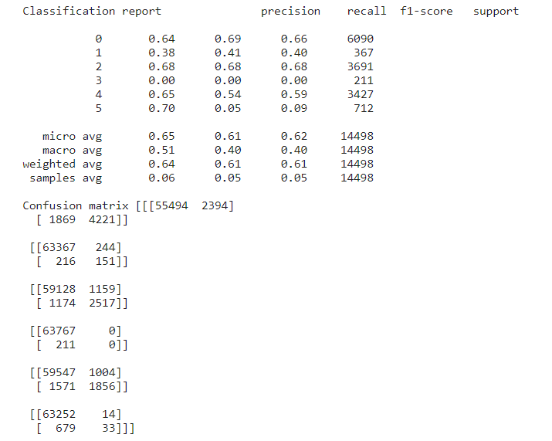

Slide 21
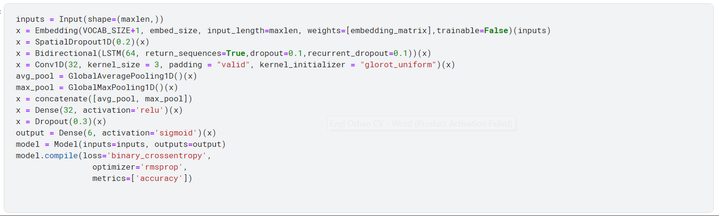
Bidirectional +Conv1d

Slide 22
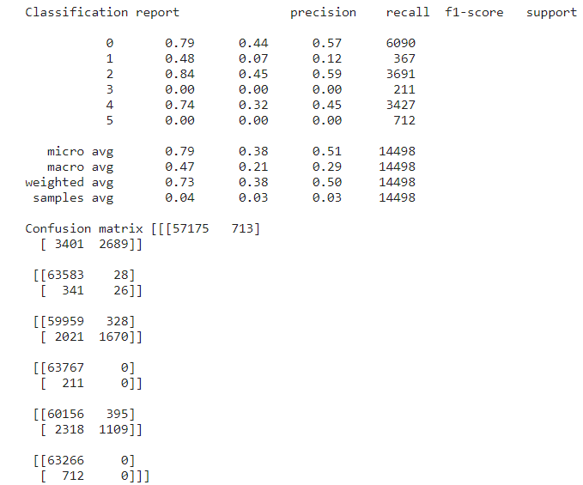

Slide 23
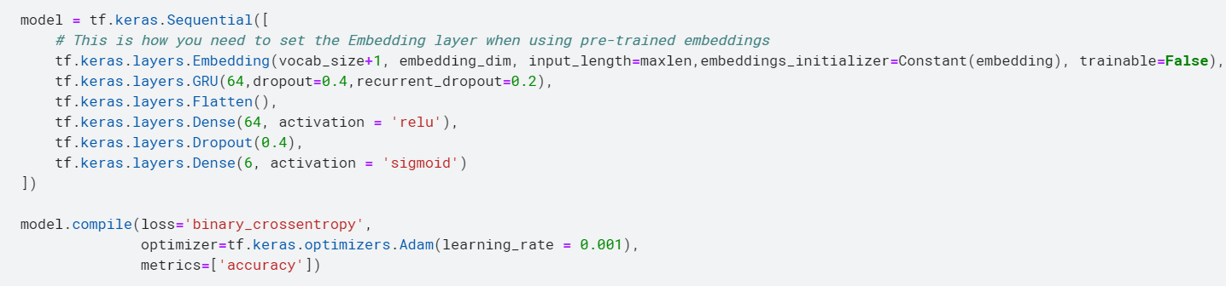
Word2vec Embedding
GRU

Slide 24
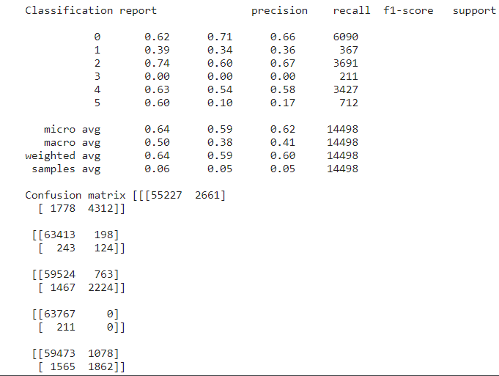

Slide 25
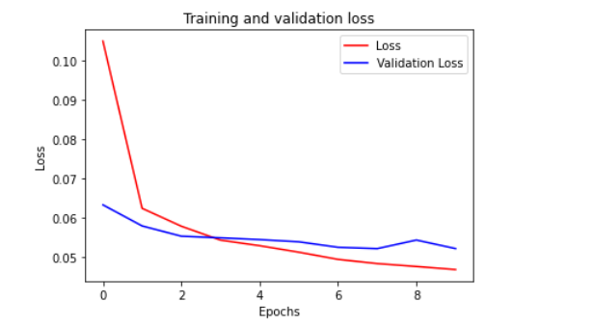

Slide 26
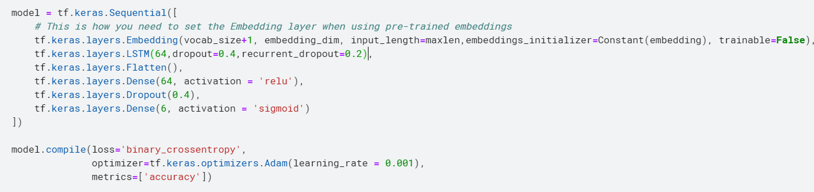
LSTM

Slide 27
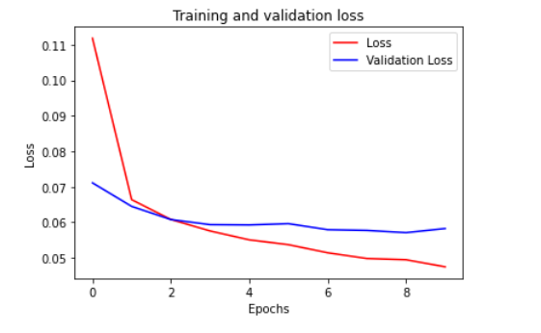

Slide 28
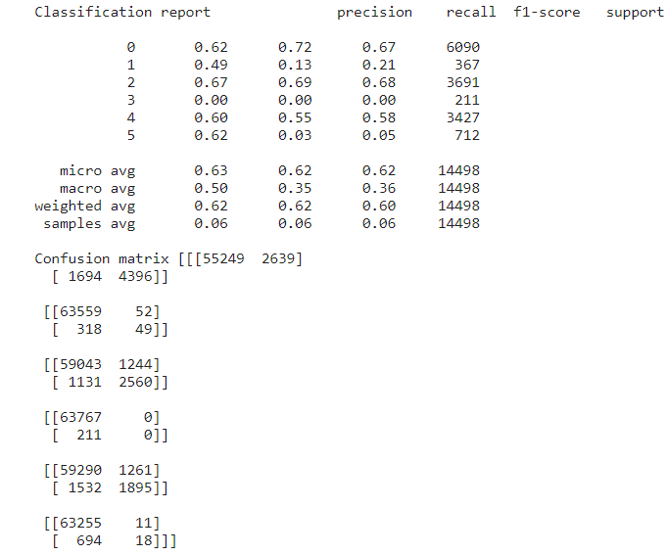

Slide 29
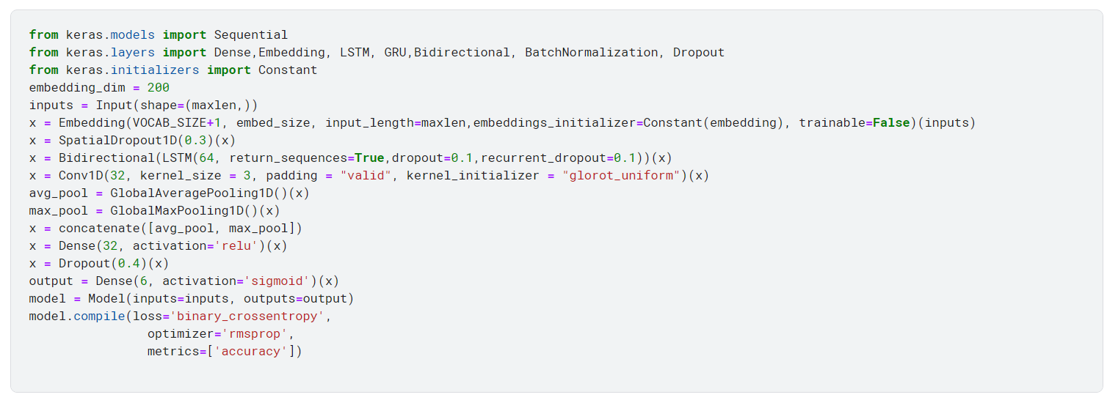

Slide 30
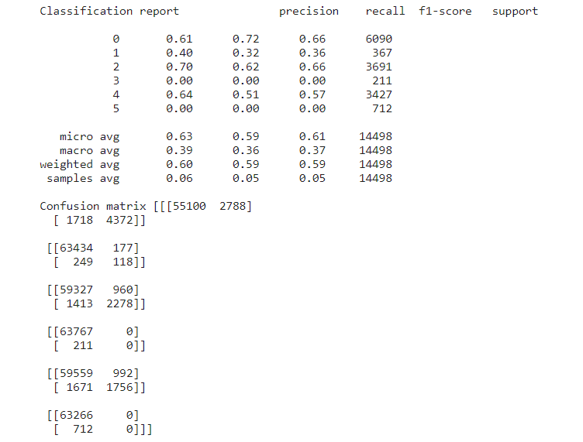

Slide 31
Conclusion
Glove and Word2vec Embeddings are used
LSTM,GRU layers and BiLSTM + CNN layers are tested
 | microAverages | Precision | Recall | F1-score
Glove | CNN | 0.7 | 0.42 | 0.53
 | GRU | 0.64 | 0.62 | 0.63
 | LSTM | 0.65 | 0.61 | 0.62
 | BiLSTM+CNN | 0.79 | 0.38 | 0.51
Word2vec | GRU | 0.64 | 0.59 | 0.62
 | LSTM | 0.63 | 0.62 | 0.62
 | BiLSTM+CNN | 0.63 | 0.59 | 0.61

Slide 32
Core Skills
Positive challenge
Self-compassion
Resilience

Slide 33
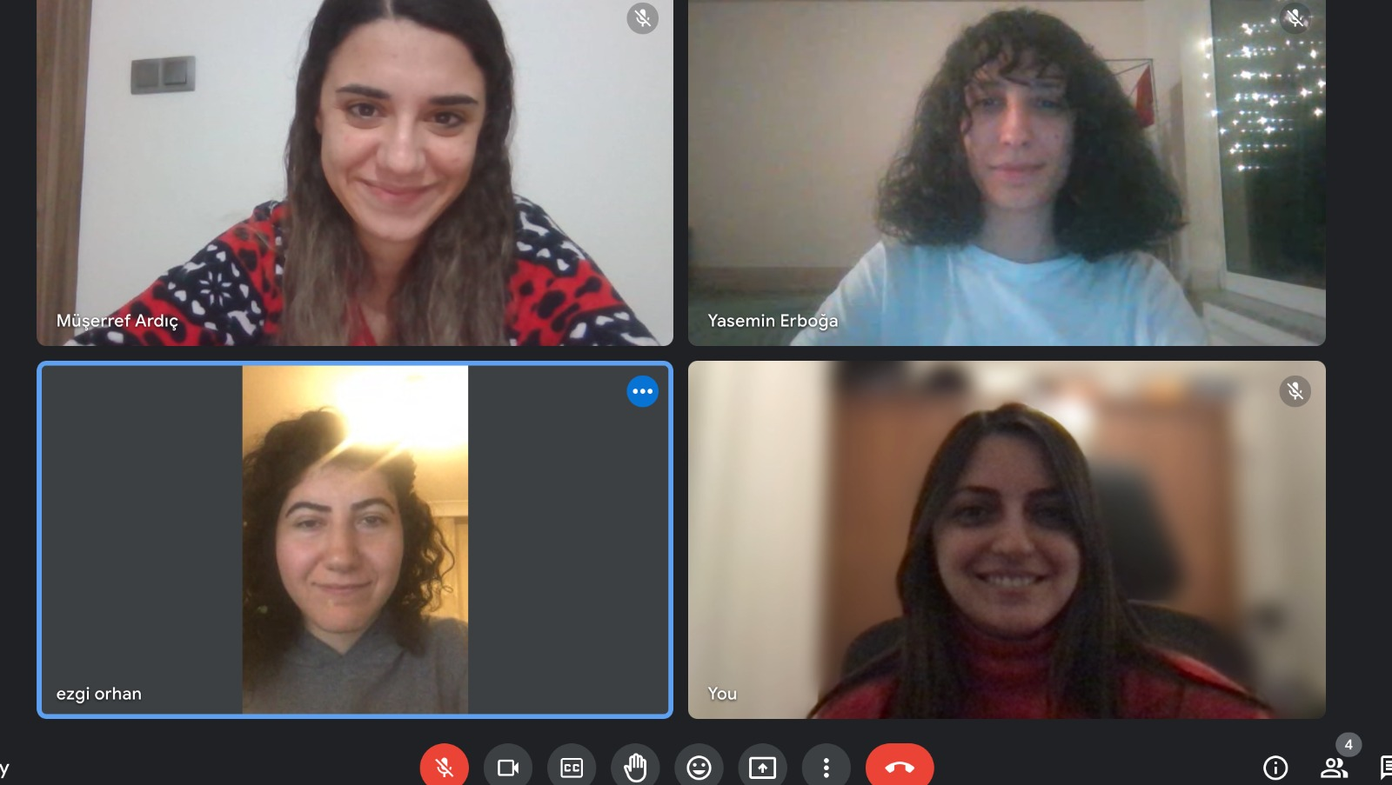
Core skills
Defining and Stating our feelings
Support
Energy management

